Slide 1
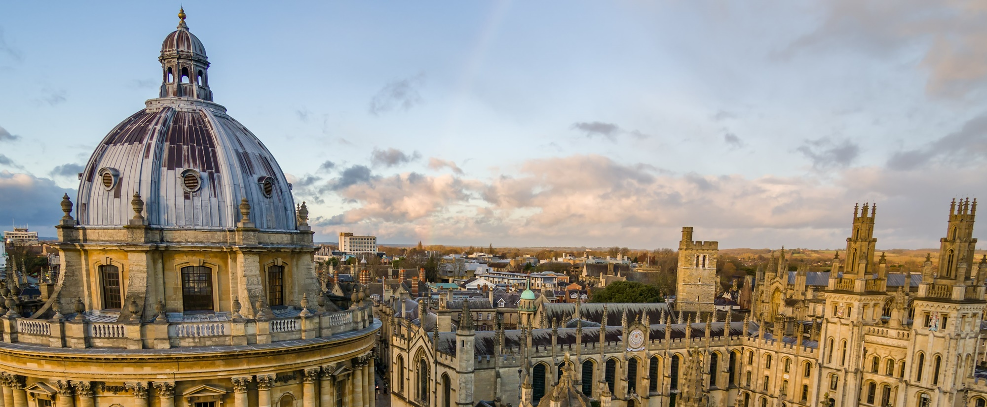
Saumya Jetley
Final-year* PhD Student
Department of Engineering Science
University of Oxford
Supervised by: Prof. Philip Torr
* defending soon
Notes:
Introduction: Final year PhD student in the Torr Vision Group, Department of Engineering Science, University of Oxford.
Supervised by Prof. Philip Torr

Slide 2

Department of Engineering Science, University of Oxford
My Research
Prototypical Priors: From Improving Classification to Zero-Shot Learning
End-to-End Saliency Mapping via Probability Distribution Prediction
Straight to Shapes: Real-time Detection of Encoded Shapes
Learn to pay attention: Adapting attention mechanism in convnets
With Friends Like These, Who Needs Adversaries?
Use of CNNs for scene understanding
Examination of CNNs
Notes:
During my PhD research, I have focused on the ‘Use and Examination of Convolutional Neural Networks for Scene Understanding’.
- In the early projects, I focused on augmentations to conventional CNN pipelines to better adapt them to the underlying visual tasks such as object recognition, zero-shot object recognition, human saliency prediction and instance segmentation.
- I then shifted my focus to better understanding the behaviour, functions and decision-making implemented by classification CNNs, first at a qualitative level and then at a more analytical level.

Slide 3
Department of Engineering Science, University of Oxford
My Research
Prototypical Priors: From Improving Classification to Zero-Shot Learning
End-to-End Saliency Mapping via Probability Distribution Prediction
Straight to Shapes: Real-time Detection of Encoded Shapes
Learn to pay attention: Adapting attention mechanism in convnets
With Friends Like These, Who Needs Adversaries?
Use of CNNs for scene understanding
Examination of CNNs
Notes:
In this presentation, I will talk about our most recent work titled – “With friends like these, who needs adversaries“.
This work examines the functions implemented by classification CNNs with the view to explaining their behavioural properties.

Slide 4
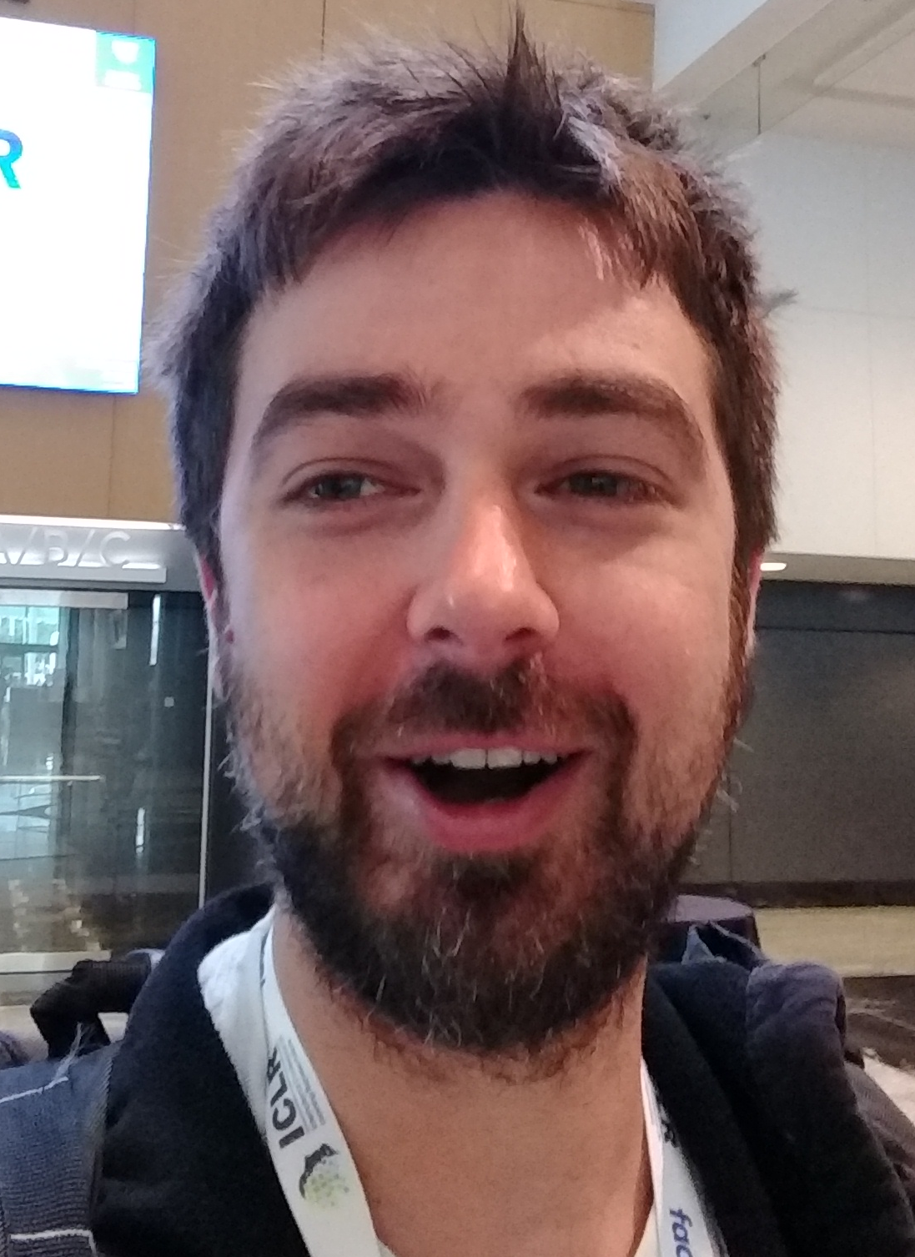
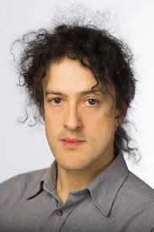
Department of Engineering Science, University of Oxford
Collaborators (With friends like these…)
Nicholas A. Lord
Philip H.S. Torr
Notes:
This is joint work with Nicholas Lord (a former post-doc in Torr vision group) and my supervisor Phil Torr.

Slide 5
Department of Engineering Science, University of Oxford
Motivations (With friends like these…)
To better understand and explain the following for deep nets:
Generalisability
Adversarial vulnerability
Resolve the standing contradiction between the two
Notes:
Before we discuss the findings of our research paper, let’s look at some of the motivations for analysing these networks.

Slide 6
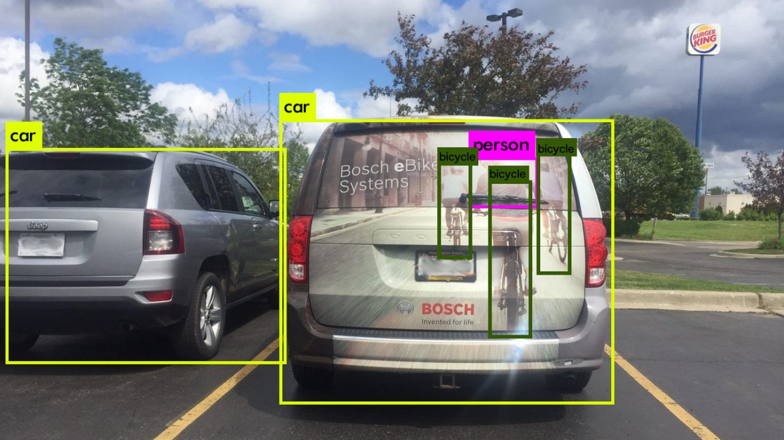
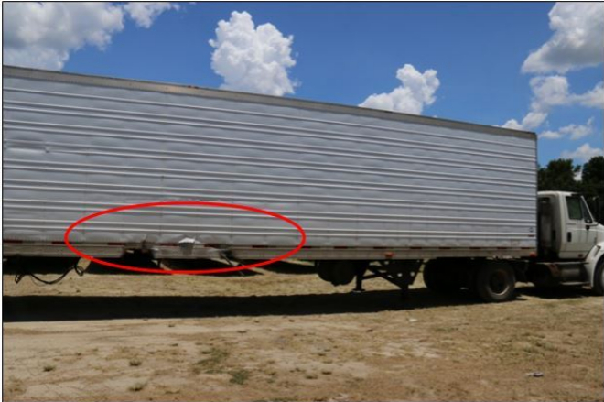
Department of Engineering Science, University of Oxford
Generalisability
Performance in the Wild!
‘False positives’ ‘False negatives’
Notes:
(a) To understand and predict their real-world behaviour

Slide 7
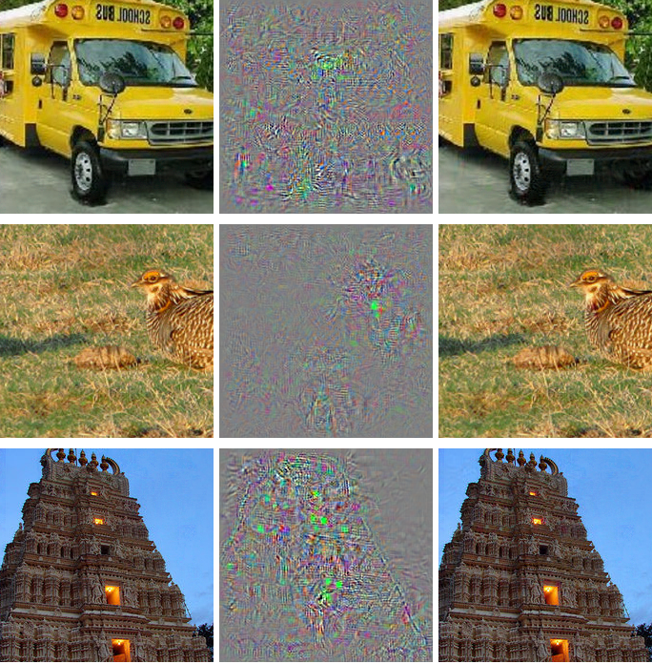
Department of Engineering Science, University of Oxford
Adversarial vulnerability – TL;DR
I
∆I
I+∆I
C(I) ≠ C(I+∆I)
Notes:
(b) To explain the cause and the implications of their adversarial proneness.
For those who are not familiar with adversarial vulnerability,

Slide 8
Department of Engineering Science, University of Oxford
INPUT
IMAGE
Convolution
Pooling
ReLU
SoftMax
Notes:
In order to understand the behavior of deep CNNs, let us take a closer look at how they respond to their inputs.
- A sneak peak into one of the major findings of our work.

Slide 9
Department of Engineering Science, University of Oxford
INPUT
IMAGE
1
2
3
4
5
6
7
8
9
10
NIN
air-
plane
auto-
mobile
bird
cat
deer
dog
frog
horse
ship
truck
Notes:
We observe the output class scores for the 10 output classes for a Network-in-Network architecture trained on CIFAR-10 dataset.
Basically, the real-valued class scores tell us how much the net thinks that the class corresponding to each node is present in the input.

Slide 10
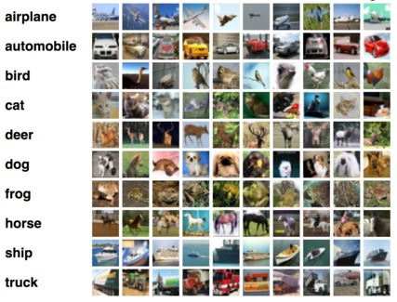
Department of Engineering Science, University of Oxford
CIFAR-10 Dataset
Notes:
CIFAR-10 dataset
60000 images of 10 different target categories
50000 in the test set and 10000 in the train set.

Slide 11


Department of Engineering Science, University of Oxford
1
2
3
4
5
6
7
8
9
10
-4.47
-8.27
0.28
12.82
-0.74
35.37
-3.26
1.90
-13.49
-4.70
air-
plane
auto-
mobile
bird
cat
deer
dog
frog
horse
ship
truck
Notes:
Let us input this image of a CIFAR dog. Now what if we blend in this special pattern?

Slide 12
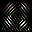
Department of Engineering Science, University of Oxford
(
)
PERTURBED
INPUT
IMAGE
s
1
2
3
4
5
6
7
8
9
10
?
?
?
?
?
?
?
?
?
?
air-
plane
auto-
mobile
bird
cat
deer
dog
frog
horse
ship
truck
Notes:
How do the class scores change?

Slide 13

Department of Engineering Science, University of Oxford
(
)
s
-1500
1500
1
2
3
4
5
6
7
8
9
10
?
?
?
?
?
?
?
?
?
?
air-
plane
auto-
mobile
bird
cat
deer
dog
frog
horse
ship
truck
Notes:
First, observe how the perturbed image changes as the perturbation scaling factor s varies over the chosen range.

Slide 14
Department of Engineering Science, University of Oxford
(
)
s
-1500
1500
1
2
3
4
5
6
7
8
9
10
air-
plane
auto-
mobile
bird
cat
deer
dog
frog
horse
ship
truck
Notes:
Let’s do that again, but this time, look down at how the output class scores change as the perturbation scaling factor is varied.

Slide 15

Department of Engineering Science, University of Oxford
(
)
s
“frog”
1
2
3
4
5
6
7
8
9
10
air-
plane
auto-
mobile
bird
cat
deer
dog
frog
horse
ship
truck
Notes:
The frog class score increases monotonically with the magnitude of the scale factor, surpassing all other scores, including the dog score.
So the network thinks this is a frog.

Slide 16
Department of Engineering Science, University of Oxford
(
)
1500
“dog”
“frog”
Notes:
Now there’s nothing special about this particular dog image.

Slide 17


Department of Engineering Science, University of Oxford
(
)
-480
“dog”
“frog”
Notes:
The same thing happens with this dog.

Slide 18


Department of Engineering Science, University of Oxford
(
)
360
“cat”
“frog”
Notes:
Or nearly

Slide 19


Department of Engineering Science, University of Oxford
(
)
510
“horse”
“frog”
Notes:
Any other

Slide 20


Department of Engineering Science, University of Oxford
(
)
-1250
“automobile”
“frog”
Notes:
image

Slide 21


Department of Engineering Science, University of Oxford
(
)
520
“ship”
“frog”
Notes:
in the set.

Slide 22


Department of Engineering Science, University of Oxford
(
)
1500
“frog”
“frog”
(more so)
Notes:
Except the frog, which DOESN’T change its identity.

Slide 23
Department of Engineering Science, University of Oxford
Notes:
This trend is evident at the population level. Here are the class-score percentile lines for the entire dataset as a function of the scaling factor.
Frog score in red.
And the highest-scoring non-frog in blue.
Notice the crossover of the curves.

Slide 24
Department of Engineering Science, University of Oxford
“towards frog”
Notes:
In other words, this perturbation is a frog-class-targeting universal adversarial perturbation.

Slide 25
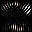


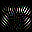
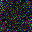
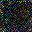
Department of Engineering Science, University of Oxford
“towards frog”
“towards deer”
“towards auto-mobile”
“away from bird”
“away from horse”
“no effect”
“no effect”
(and many, many more)
Notes:
This is just one example. We can identify a family of patterns that move predictions towards or away from *any* given class, or have no effect on class identity at all, and we can do it on whichever network. In fact, we can think of image space as being spanned by bases of patterns like this.

Slide 26
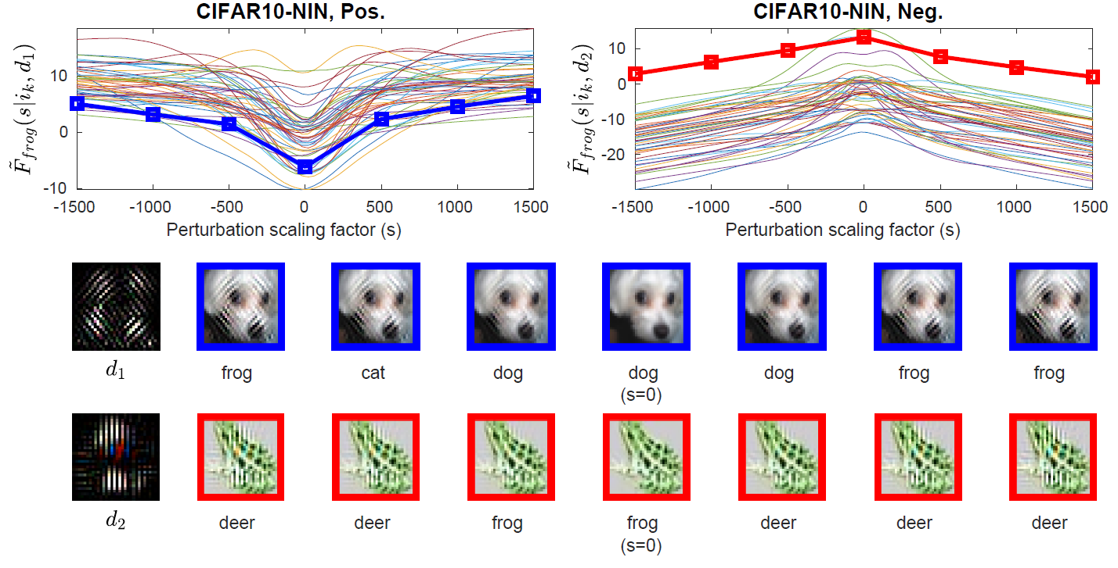
Department of Engineering Science, University of Oxford
With Friends Like These, Who Needs Adversaries?
Notes:
Let us take a moment to notice some simplistic aspects of the class score functions along these directions.
Fairly monotonic change in the output class score wrt the magnitude of component in the given direction
Context-free relationship between the magnitude of component in the specific direction and the value of the output class score.
The semantics of the direction (when viewed as a 2D image) do not correspond in any way to the notion of the class as per human vision.

Slide 27
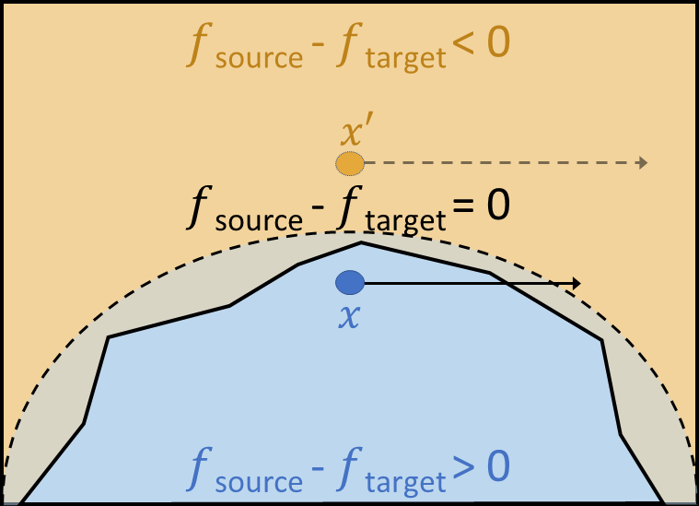
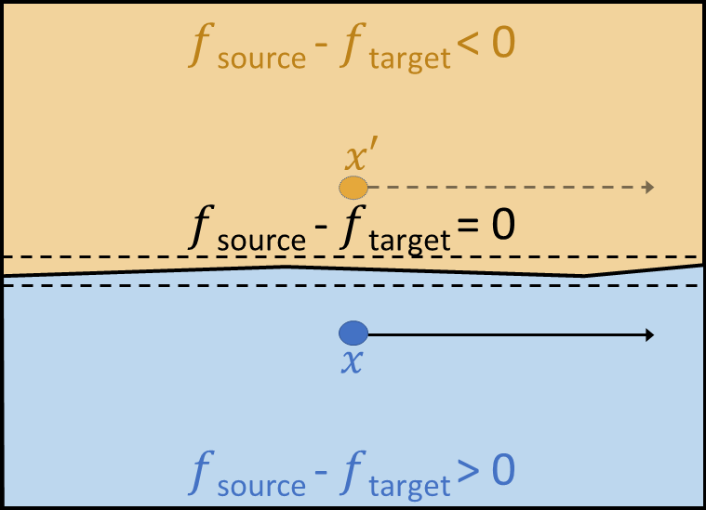
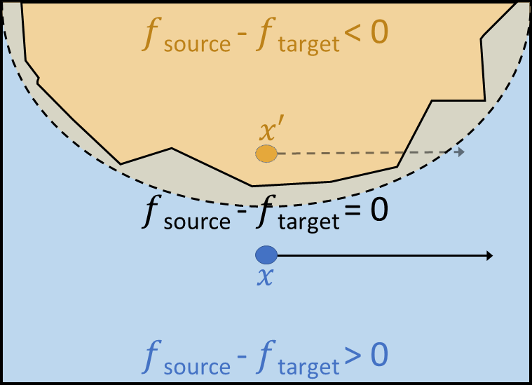
Department of Engineering Science, University of Oxford
Decision boundary curvature analysis
We extend and contextualise the framework for curvature analysis of deep network decision boundaries by Dezfooli et al.
Positive curvature bound
Flat curvature bound
Negative curvature bound
Notes:
The directions are the outcome of the curvature analysis of deep network decision boundaries, first presented in Moosavi-Dezfooli et al.
Start from a given image point
Perturb it to the closest class decision boundary
Evaluate the Hessian of the decision function (zero-set of the difference between the score function of the original class and that of the perturbed-sample class)
Compute the Hessian at many such points on the decision boundary starting from randomly sampled images
Compute the mean Hessian
Perform an Eigen decomposition to obtain principal curvature and principal directions.
Discuss the intuition of positive-curvature, negative-curvature and zero-curvature directions.

Slide 28
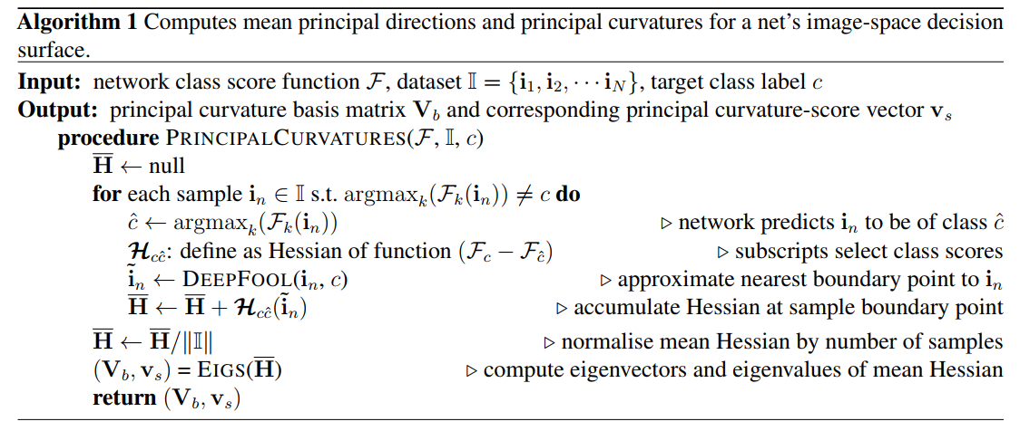
Department of Engineering Science, University of Oxford
Decision boundary curvature analysis
Notes:
The directions are the outcome of the curvature analysis of deep network decision boundaries, first presented in Moosavi-Dezfooli et al.
Start from a given image point
Perturb it to the closest class boundary
Evaluate the Hessian of the decision function (zero-set of the difference between the score function of the original class and that of the perturbed-sample class)
Compute the Hessian at many such points on the decision boundary starting from randomly sampled images
Compute the mean Hessian
Perform an Eigen decomposition to obtain principal curvature and principal directions.
Discuss the intuition of positive-curvature, negative-curvature and zero-curvature directions.

Slide 29
Department of Engineering Science, University of Oxford
Decision boundary curvature analysis
We extend and contextualise the framework for curvature analysis of deep network decision boundaries by Dezfooli et al.
Positive curvature bound
Flat curvature bound
Negative curvature bound
Notes:
Significance of directions in which the decision surface exhibits – high positive curvature, high negative curvature and flat curvature.

Slide 30
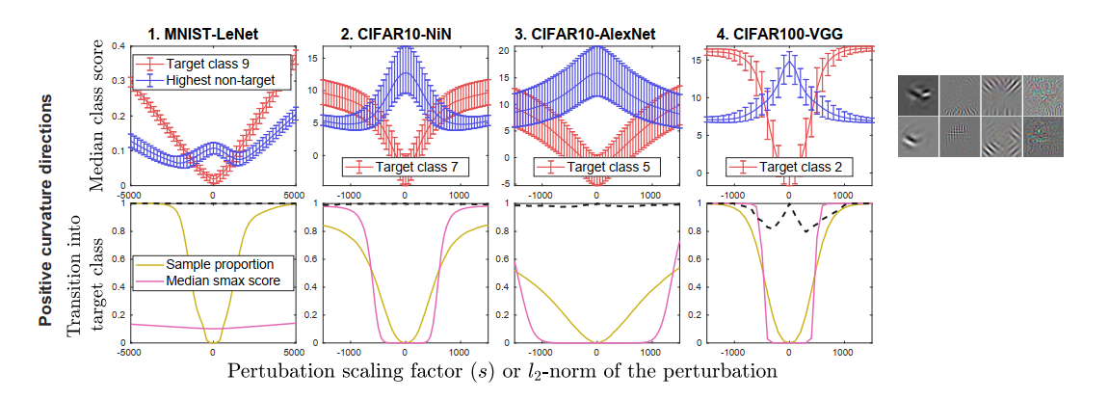
Department of Engineering Science, University of Oxford
Class Identity as f(component in high-curvature dirs.)
Notes:
- Positive curvature directions take you into specific classes

Slide 31
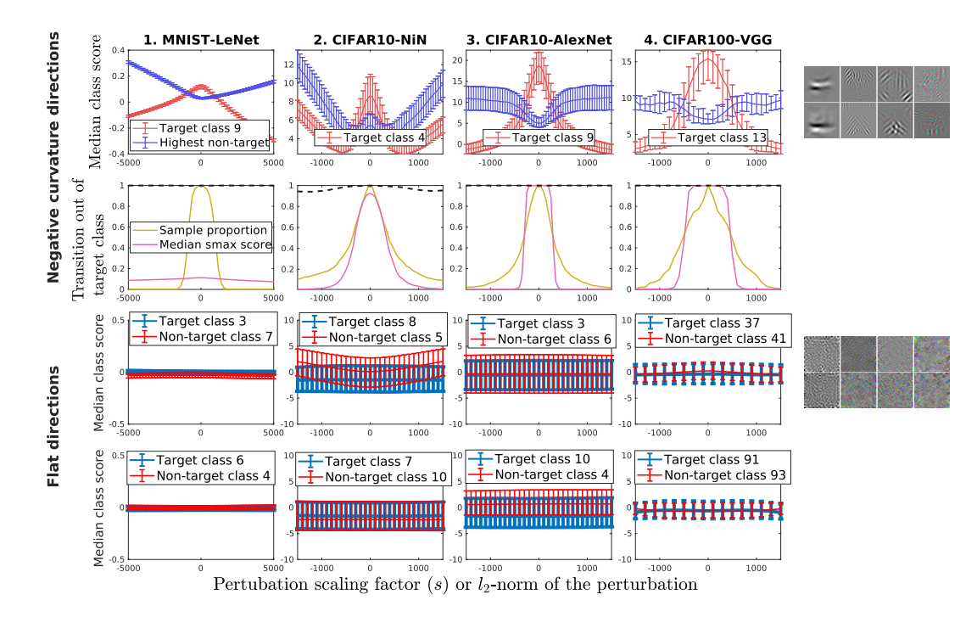
Department of Engineering Science, University of Oxford
Notes:
Negative curvature directions take you away from specific classes
Flat curvature directions have no effect on the output class scores whatsoever and hence don’t alter the class decisions

Slide 32
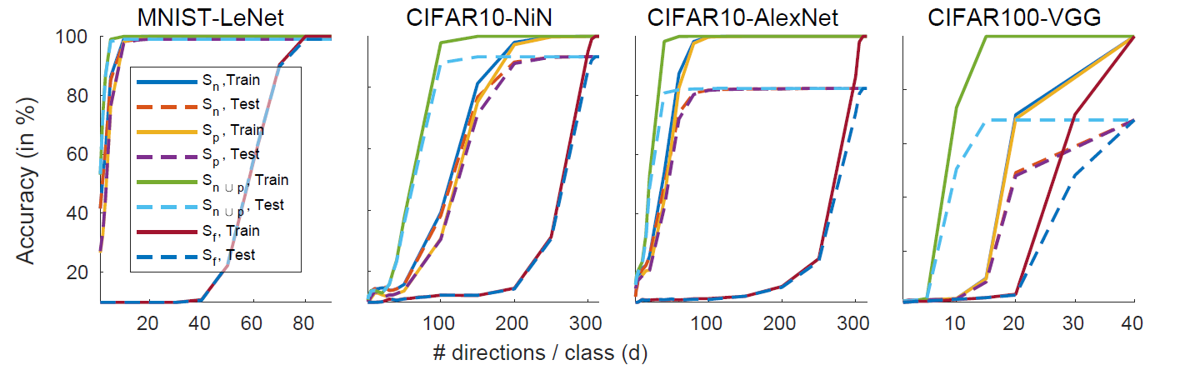
Department of Engineering Science, University of Oxford
Train/Test Acc. as f(component in high-curvature dirs.)
Various DCNs' training and test classification accuracies on image sets projected onto the respective subspaces as a function of the dimensionality parameter d (per class).
Notes:
The input subspace is parametrised by a dimensionality parameter ‘d’, which controls the number of basis vectors selected per class for orthonormalisation by QR decomposition.
The input images are projected onto this subspace, then mapped back to the original space, before being passed through the network to see the effect on the output performance accuracy.
This analysis would help us confirm the importance of certain directions (and the components along those directions) in driving the net’s class prediction.
We use four variants of selection to establish the subspace for projection: the ‘d’ most positively curved directions per class (yielding the subspace ‘S_p’); the ‘d’ most negatively curved directions per class (yielding the subspace ‘S_n)’; the union of the previous two (subspace ‘S_{n U p}’); and the ‘d’ least curved (flattest) directions per class (subspace ‘S_f’).
The principal directions defining the subspaces are obtained by applying ‘principal curvature analysis’ once for each possible choice of target class ‘c’, with ‘d’ selecting how many are retained per class.
Note the relationship between the ordering of curvature magnitudes and classification accuracy by comparing the ‘S_f’ curves to the others.

Slide 33
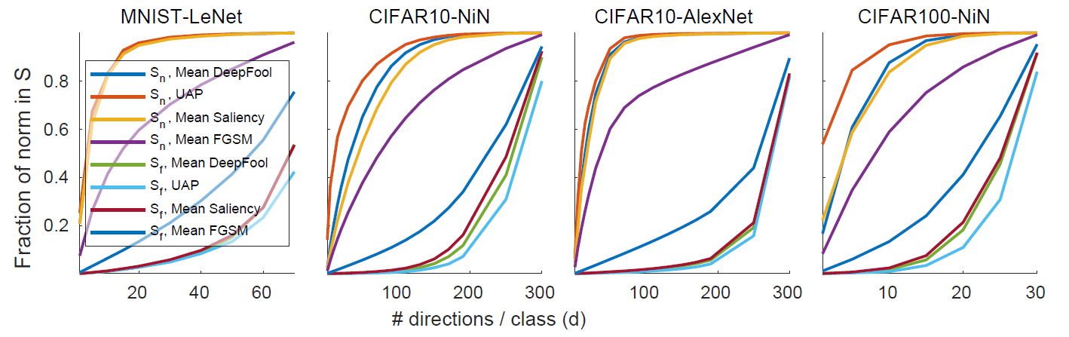
Department of Engineering Science, University of Oxford
Adversarial norm as f(component in high-curvature dirs.)
Mean fractional l₂ norms (as a fraction of their original norms) of the projections of various adversarial perturbations (DeepFool, FGSM and UAP) and saliency maps onto different subspaces.
Notes:
Different adversarial attack vectors and also the saliency maps exhibit a considerably high component in the high-curvature directions.
Note that this is also where the majority of the classification performance lies.

Slide 34
Department of Engineering Science, University of Oxford
ImageNet (big data) woes
First-order analysis to the rescue!
Direct association between high-curvature and high local gradients
First-order attack methods have significant component in the subspace of interest
Notes:
- Simplifying the analysis for datasets with large number of classes, where extracting the classification directions via per class decision-boundary curvature analysis may become computationally intensive: Eigen decomposition of stacked gradients

Slide 35
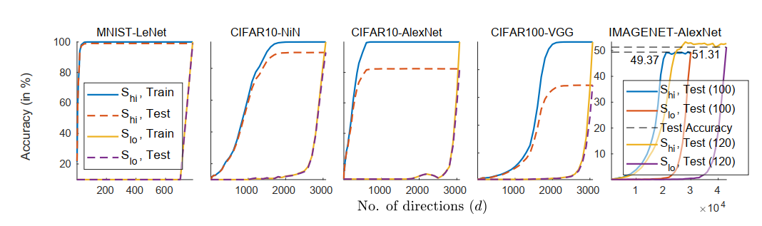
Department of Engineering Science, University of Oxford
Test/Train Acc. as f(component in high singular-value dirs.)
Various DCNs' training and test classification accuracies on image sets projected onto the respective subspaces as a function of the dimensionality parameter d (class agnostic selection).
Notes:
Note: Explain the downsampling of imagenet data: to be able to perform the eigen-decomposition in a lower-dimensional space (for ease of analysis)
More importantly, we get the same test/train accuracy curves by ordering directions as per their principal gradients as by ordering them according to their principal curvatures.

Slide 36
Department of Engineering Science, University of Oxford
Implications for
Accuracy & Robustness Tradeoff
Especially w.r.t works that propose to improve robustness via:
Input data compression
Network feature suppression
Notes:
Armed with the understanding that the same directions which are used for classification are the ones that are exploited by the adversarial attack methods, let us challenge the myth of being able to robustify networks without loss of classification accuracy.

Slide 37
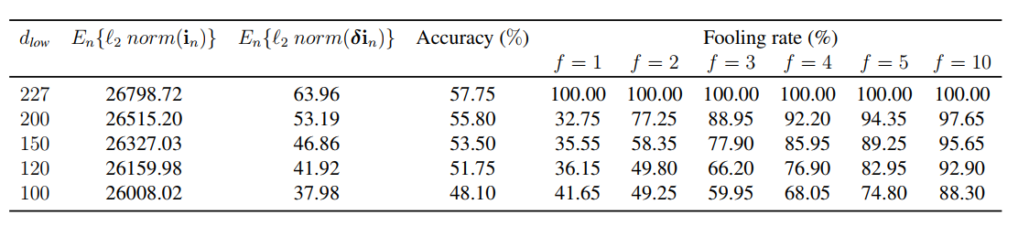
Department of Engineering Science, University of Oxford
Image Compression: Accuracy vs Robustness Myth
Test accuracy and fooling rates as a function of the input image compression defined in terms of the down-sampling factor d_{low} . Effects of increasing the norm of the downsampled deepfool.

Slide 38
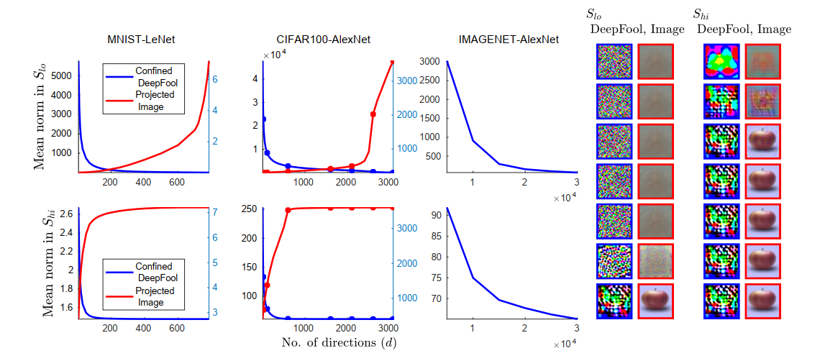
Department of Engineering Science, University of Oxford
Confined Attacks (DeepFools)
Designing optimal (deepfool) attacks in confined sub-spaces
Notes:
The seeming boost in robustness is because the attack is a transfer attack, designed for the original model but attacking the modified model with the resampling unit.
What if we now design the attack to be optimal within confined subspaces?
Observation:
Deepfools will be low norm as long as they are optimized within the directions that are useful for classification (i.e. directions with high principal gradients).
They need to have a high norm to be effective iff they are confined to directions with low principal gradients.
But operating in low principal gradient directions also implies that the network has lost all ability to distinguish the classes, which means they there is no accuracy to begin with and robustness is irrelevant.

Slide 39
Department of Engineering Science, University of Oxford
Conclusion
As it currently stands, in some sense of speaking, nets’ features are their worst adversaries.

Slide 40
Department of Engineering Science, University of Oxford
Open Questions!
Can the networks even learn more complex features?
Is it a property of the network architecture?
Is it a by-product of the learning algorithm – SGD?
How can we begin to bring causality into the picture?

Slide 41
Department of Engineering Science, University of Oxford
Thank You!

